Slide 1

Domain: Android
Bookworms Circle

Slide 2

PIP104 University Project-II
Review-4
Bookworms Circle (Android / Android Application)
Batch Number:CST-03
Under the Supervision of,
Ms. Riya Sanjesh
Assistant Professor-Selection Grade
School of Computer Science & Engineering
Presidency University
20201CST0016 | J Sri Ranga Dinesh
20201CST0078 | K Rajesh Kumar Reddy
20201CST0045 | P Parameshwar Reddy
20201CST0054 | U Bharath Karthik Rao
20201CST0027 | Sritha Kanala

Slide 3
INDEX
Abstract
Introduction
Literature review
Existing Method
Drawbacks
Proposed method
Advantages
Hardware and Software Requirements
Conclusion
References

Slide 4
Abstract
Sharing books is the most basic form of sharing knowledge. The project aims at providing digital platform through out android application, to encourage readers to form a circle and enjoy reading the books closed by the publications and the high-cost books which can’t by other readers. This reader to connect with likeminded people, with the people those who have similar hobbies, similar reading lines preferences etc., through our android application they can find the books, which they are in search and find book owners and can request book For reading and return it back over a time.

Slide 5
Introduction
.
In this world,some people have so much interest to read the book,but they don't have sufficient amount to buy the book.So,we implementing android application such time of people.In this android application,reader to connect with like minded people,with the people who have similar hobbies,similar reading lines through our android application ,they can find the book.They can search and find the book owners and can request a book and return it back over a time.

Slide 6
Methodology
User: Used by people to share hardcopies of books with each other. The user can register first after that need to login and add the books and exchange books each other.
Admin: Admin will login, seamlessly add books to create a personalized digital library experience. Streamlined access and book management enhance the user's interactive and efficient engagement.
.

Slide 7
Existing method:
In existing system a lack of diversity in the reading material and limit the group's exposure to different genres, authors, and viewpoints. Some may have read the book thoroughly and have a lot to contribute, while others may have only skimmed the material or have different reading preferences altogether.
Disadvantages in Existing method:
The ui is not Friendly.
The user can get proper book from other users.

Slide 8
Proposed method:
The proposed system the user has share books, take a picture of the book and enter all it’s details. the user needs a book search keywords about the book. To find the book contact the book owner . Finally exchanges the book on mutual interest.
Advantages of Proposed method:
The ui is Friendly.
The user can get different books are not found in shops.
The rare books to read for other user support.

Slide 9
Hardware and Software Requirements
H/W System Configuration: -
Processor - I3/Intel Processor
RAM - 8 GB
Hard Disk - 1TB
S/W System Configuration: -
Operating System - Windows 10
JDK - java
Plugin -Kotlin
SDK - Android
IDE -Android studio
Database` -SQL

Slide 10
Literature Survey
Year | Author | Title | Description
2020 | shafaque Ahmareen, Ayeshwarya Raj,Sirisha Potluri | Book Shala: An Android-Based Application Design and Implementation of Sharing Books | To reduce the cost of getting knowledge and information for its users and building a community with an awesome experience. The proposed model is deployed on android-based mobile phones connecting to users. Some key feature of this model is speech recognition, wallet system, and prediction that give clues to customer’s next buy
2020 | Cheng Luo and Ying Chen | Design and Research of Private Book Sharing System Based on Sharing Economy Model | the modern shared economy model of private book sharing systems. stand by. Experimental research results show that by creating a shared platform, more idle resources can be used more effectively to meet people's more diverse needs. In addition, the establishment of a shared platform helps to establish and improve the supervision and management mechanism
2022 | Sverre Hendseth | Application for sharing books within second home areas | This application is created as a supplement to the existing solutions and differs by focusing on sharing books within second home areas. The project, in its entirety, has consisted of two parts, a specialization project and this master’s thesis. To realize the idea of book sharing within second home areas, the specialization project started by determining the requirement specifications for a web application. Then, with the knowledge gained from interactions and literature review, a web application for Hyttebiblioteket was developed.

Slide 11
Possible Outcomes
The project's potential outcomes include fostering a vibrant community of readers, encouraging knowledge sharing through a digital platform. Users can connect based on similar interests, discover sought-after books, and request loans, promoting accessibility to high-cost publications. This initiative aims to facilitate a collaborative reading experience, democratizing access to literature and fostering a sense of community among like-minded individuals.

Slide 12
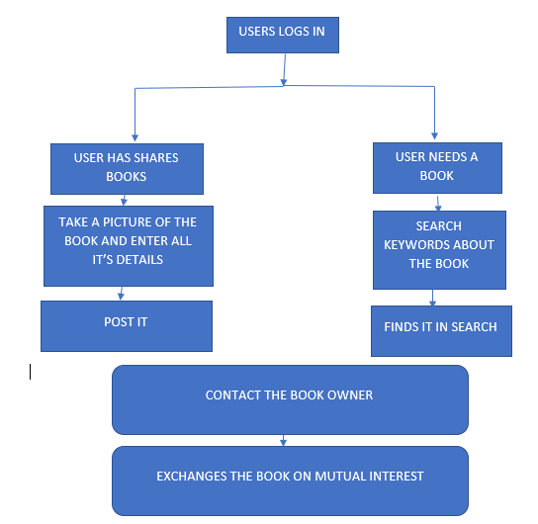
Architecture

Slide 13
Conclusion:
In the context of the rapid development of the sharing economy system in China, private shared books take "Internet + books" as the core, and the book reading under the connection of Internet big data technology realizes the temporary transfer of book use rights and effectively improves the whole society. The reading environment has greatly reduced reading costs, changed the status quo of Chinese people who have fewer books, expensive books, and inconvenience in borrowing and returning books. Private books that use digital sharing systems can not only enrich collection resources, but also achieve resource and information sharing, and improve private books.

Slide 14
References:
J. Shi, X. Wang, J. Liu, M. Zhang, and M. Huang, “Content-centric community-aware mobile social network routing scheme”, 2018
M. Corciolani and D. Dalli, “Gift-giving, sharing and commodity exchange at bookcrossing. com: new insights from a qualitative analysis”, 2014
Chuen-Yu Chen and Anne James, Applications of CRM to Consumer Behaviour in the Electronic Bookstore Environment,2004.
Muzumdar, P.: The University of Texas at Arlington ‘Online book sharing system a new trendin textbook sales management for services marketing, 2009.
Arcidiacono D , Gandini A , Pais I . Sharing what? The 'sharing economy' in the sociological debate[J]. Sociological Review, 2018 .

Slide 15





